Slide 1
The searching method
Meeting 6

Slide 2
Searching method
Searching by:
Video ID
Travelling Type
Video Category

Slide 3
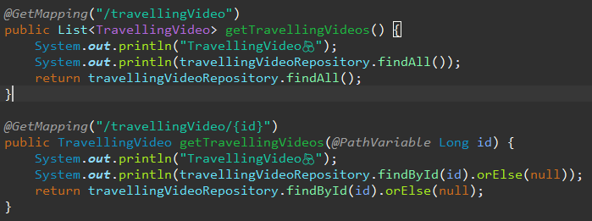
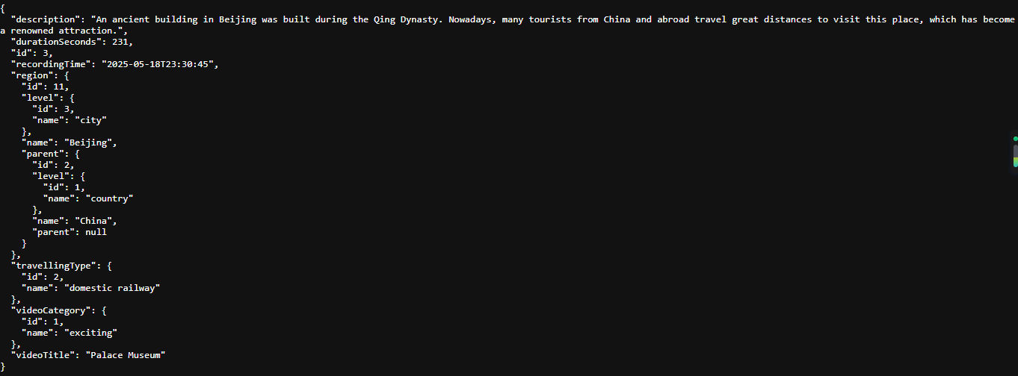
Search by Video ID
http://localhost:8080/api/travellingVideo 找出所有的视频
http://localhost:8080/api/travellingVideo/3 之后只显示唯一一条视频，比如id=3
id=3
缺点，通过id找，记不住每一个ID对应的视频，Not user friendly.

Slide 4
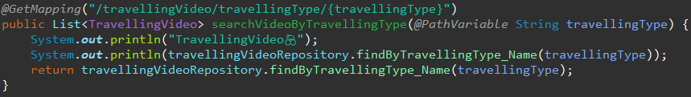
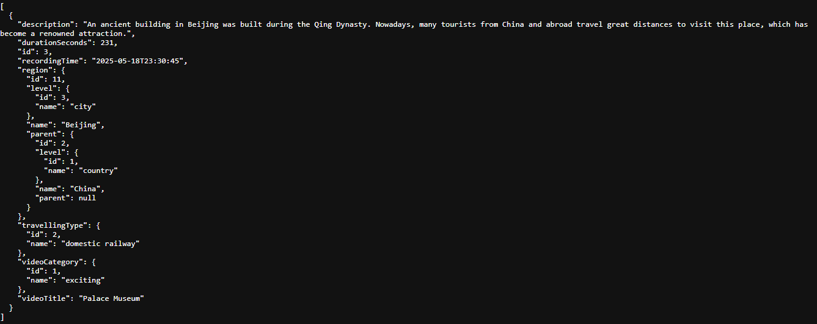
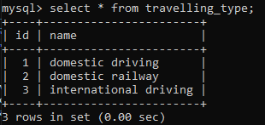






Searching by Travelling Type
比如说我选择domestic railway出行方式

Slide 5
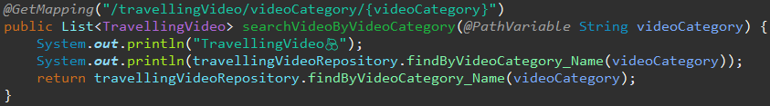

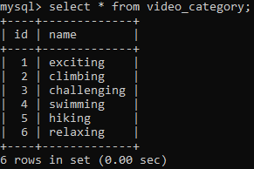






Searching by Video Category
比如说我选择exciting的视频类型

Slide 6
Next Step
Search by Travelling Type + City ID
Add a new field named url in class TravellingVideo.
Create frontend template in Vue.js. (head, top-nav, contents, footer)
When I click “domestic driving” tab, pop up a Cascading Dropdown menu. First level only.

